Slide 1
Inheritance, Polymorphism, and Interfaces. Oh My
Chapter 8 Part 2
Modified by JJ

Slide 2
Polymorphism
Notes:
Cat Example

Slide 3
Polymorphism
Inheritance allows you to define a base class and derive classes from the base class
Polymorphism allows you to make changes in the method definition for the derived classes and have those changes apply to methods written in the base class

Slide 4
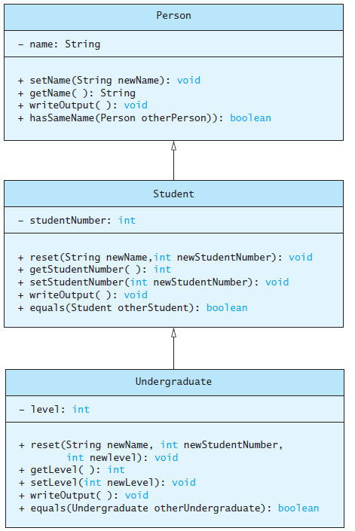
Polymorphism
Consider an array of Person
Person[] people = new Person[4];
Since Student and Undergraduate are types of Person, we can assign them to Person variables
people[0] = new Student("DeBanque, Robin", 8812);
people[1] = new Undergraduate("Cotty, Manny", 8812, 1);

Slide 5
Polymorphism
Given:
Person[] people = new Person[4];
people[0] = new Student("DeBanque, Robin", 8812);
When invoking:
people[0].writeOutput();
Which writeOutput() is invoked, the one defined for Student or the one defined for Person?
Answer: The one defined for Student

Slide 6
Dynamic Binding and Inheritance
When an overridden method invoked
  Action matches method defined in class used to create object using new
  Not determined by type of variable naming the object
Variable of any ancestor class can reference object of descendant class
  Object always remembers which method actions to use for each method name

Slide 7
Interfaces
Notes:
Cat Example

Slide 8
An Inheritance as a Type
The method can substitute one object for another
  Called polymorphism
This is made possible by mechanism
  Dynamic binding
  Also known as late binding

Slide 9
Class Interfaces
Consider a set of behaviors for pets
  Be named
  Eat
  Respond to a command
We could specify method headings for these behaviors
These method headings can form a class interface

Slide 10
Class Interfaces
Now consider different classes that implement this interface
  They will each have the same behaviors
  Nature of the behaviors will be different
Each of the classes implements the behaviors/methods differently

Slide 11
Java Interfaces
A program component that contains headings for a number of public methods
  Will include comments that describe the methods
Interface can also define public named constants

Slide 12
Java Interfaces
Interface name begins with uppercase letter
Stored in a file with suffix .java
Interface does not include
  Declarations of constructors
  Instance variables
  Method bodies

Slide 13
Implementing an Interface
To implement a method, a class must
  Include the phrase
  implements Interface_name
  Define each specified method
View sample class, listing 8.8
class Rectangle implements Measurable
View another class, listing 8.9 which also implements Measurable
class Circle

Slide 14
An Inheritance as a Type
Possible to write a method that has a parameter as an interface type
  An interface is a reference type
Program invokes the method passing it an object of any class which implements that interface

Slide 15
Extending an Interface
Possible to define a new interface which builds on an existing interface
  It is said to extend the existing interface
A class that implements the new interface must implement all the methods of both interfaces

Slide 16
Case Study
Character Graphics
View interface for simple shapes,
listing 8.10 interface ShapeInterface
If we wish to create classes that draw rectangles and triangles
  We could create interfaces that extend ShapeInterface
  View interfaces, listing 8.11

Slide 17
Case Study
Now view base class, listing 8.12 which uses (implements) previous interfaces
class ShapeBasics
Note
  Method drawAt calls drawHere
  Derived classes must override drawHere
  Modifier extends comes before implements

Slide 18
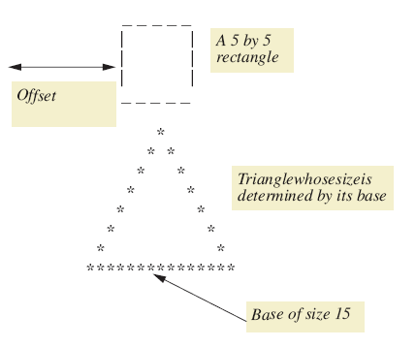
Case Study
Figure 8.5 A sample rectangle and triangle

Slide 19
Case Study
Note algorithm used by method drawHere to draw a rectangle
  Draw the top line
  Draw the side lines
  Draw the bottom lines
Subtasks of drawHere are realized as private methods
View class definition, listing 8.13
class Rectangle

Slide 20
Case Study
View next class to be defined (and tested),
listing 8.14 class Triangle
It is a good practice to test the classes as we go
View demo program, listing 8.15
class TreeDemo

Slide 21
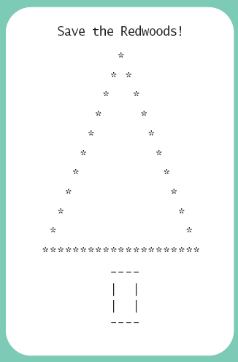
Case Study
Sample
screen output

Slide 22
Case Study
The Comparable Interface
Java has many predefined interfaces
One of them, the Comparable interface, is used to impose an ordering upon the objects that implement it
Requires that the method compareTo be written
public int compareTo(Object other);

Slide 23
Sorting an Array of Fruit Objects
Initial (non-working) attempt to sort an array of Fruit objects
View class definition, listing 8.16
class Fruit
View test class, listing 8.17
class FruitDemo
Result: Exception in thread “main”
  Sort tries to invoke compareTo method but it doesn’t exist

Slide 24
Sorting an Array of Fruit Objects
Working attempt to sort an array of Fruit objects – implement Comparable, write compareTo method
View class definition, listing 8.18
class Fruit
Result: Exception in thread “main”
  Sort tries to invoke method but it doesn’t exist

Slide 25
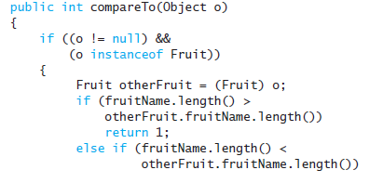
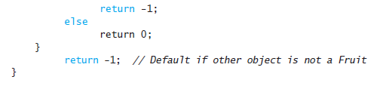
compareTo Method
An alternate definition that will sort by length of the fruit name

Slide 26
Abstract Classes
Class ShapeBasics is designed to be a base class for other classes
  Method drawHere will be redefined for each subclass
  It should be declared abstract – a method that has no body
This makes the class abstract
You cannot create an object of an abstract class – thus its role as base class

Slide 27
Abstract Classes
Not all methods of an abstract class are abstract methods
Abstract class makes it easier to define a base class
  Specifies the obligation of designer to override the abstract methods for each subclass

Slide 28
Abstract Classes
Cannot have an instance of an abstract class
  But OK to have a parameter of that type
View abstract version, listing 8.19
abstract class ShapeBase

Slide 29
Summary
An interface contains
  Headings of public methods
  Definitions of named constants
  No constructors, no private instance variables
Class which implements an interface must
  Define a body for every interface method specified
Interface enables designer to specify methods for another programmer

Slide 30
Summary
Interface is a reference type
  Can be used as variable or parameter type
Interface can be extended to create another interface
Dynamic (late) binding enables objects of different classes to substitute for one another
  Must have identical interfaces
  Called polymorphism

Slide 31
Summary
Derived class obtained from base class by adding instance variables and methods
  Derived class inherits all public elements of base class
Constructor of derived class must first call a constructor of base class
  If not explicitly called, Java automatically calls default constructor

Slide 32
Summary
Within constructor
  this calls constructor of same class
  super invokes constructor of base class
Method from base class can be overridden
  Must have same signature
If signature is different, method is overloaded

Slide 33
Summary
Overridden method can be called with preface of super
Private elements of base class cannot be accessed directly by name in derived class
Object of derived class has type of both base and derived classes
Legal to assign object of derived class to variable of any ancestor type

Slide 34
Summary
Every class is descendant of class Object
Class derived from JFrame produces applet like window in application program
Method setSize resizes JFrame window
Class derived from WindowAdapter defined to be able to respond to closeWindow button

